Slide 1




The Problem
Subspace: hospitality sector
Target audience: hotel managers, HR directors, marketing directors, rooms directors, F&B managers
Statement: Hotel managers face the challenge of meeting business goals amidst COVID-19's demand fluctuations, seeking a solution that improves forecast accuracy, optimizes operational efficiency, prioritizes guest satisfaction, and delivers measurable improvements in key metrics.

Slide 2

ADAPTIVE OPERATIONAL STRATEGIES: LEVERAGING DESIGN THINKING DURING A PANDEMIC

Slide 3

Persona
Hotel Manager: Alex Thompson
Age: 40, with over 10 years in the hospitality industry
Management Style: Collaborative and hands-on
Needs: Achieving business goals, efficient operations, staff coordination, reliable software, and positive guest feedback
Pain Points: Staff turnover, negative reviews, new technology challenges

Slide 4




Pains
Unpredictable demand
Handling guest expectations
Struggling to meet business goals
Gains
Reaching businss goals
Seamless operational flow
Improving guest satisfaction scores
Understanding Alex Thompson
THINK & FEEL
HEAR
SEE
SAY & DO
Alex is focused on efficiency and guest satisfaction, with concerns over staff retention and the hotel's reputation.
He listens to his team's insights and embraces commendations for his proactive management, yet is attuned to their worries about unpredictable schedules.
Alex's day is filled with fluctuating hotel activity, with a keen eye on peak times that test operational limits.
Advocates for leveraging tech to boost service quality and stresses the critical nature of staff preparedness and guest feedback.

Slide 5





KPIs
Customers
Alex's
Needs
Forecast
Resource Allocation

Slide 6

How might AI help?
1
AI INTENTS
Demand forecasting, customer satisfaction monitoring, KPI tracking and revenue forecasting, intelligent recommendations for staff scheduling and inventory management.
2
AI DATA
External Data: COVID-19, travelling, tourism activity, etc.
Internal Data: occupancy and revenue reports, productivity, inventory reports, etc.
3
BIG IDEA VIGNETTES
Intelligent Operational Management:
KPI tracking
Demand Forecasting
Dynamic Staff Allocation & Inventory Management

Slide 7

Hill Statement
Hotel managers can utilize AI-based intelligent operational management to track KPI achievement status, forecast market demand, and effectively manage staffing and inventory, thereby achieving optimal operational efficiency and enhancing both guest and employee satisfaction.

Slide 8
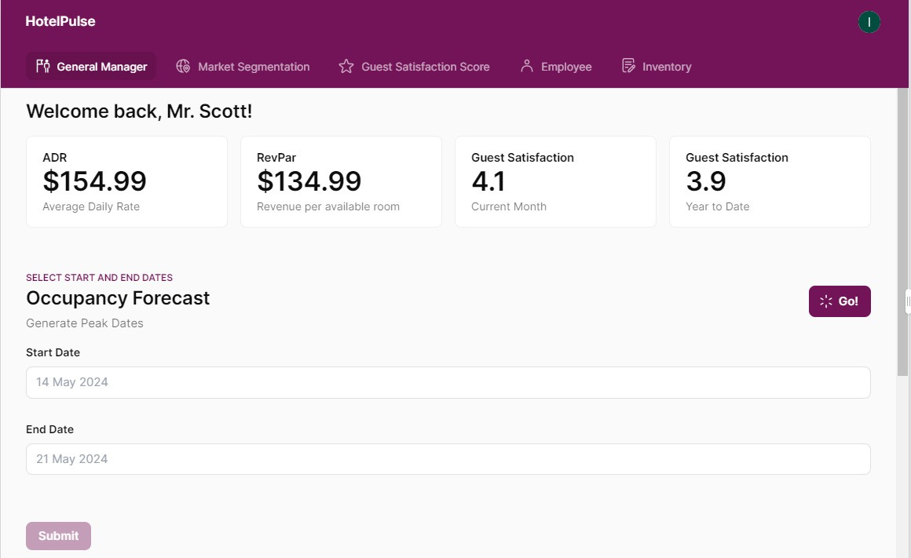
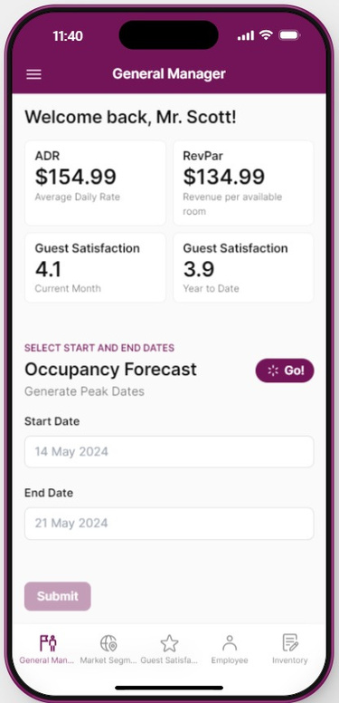
Prototypes
Customized Dashboard

Slide 9
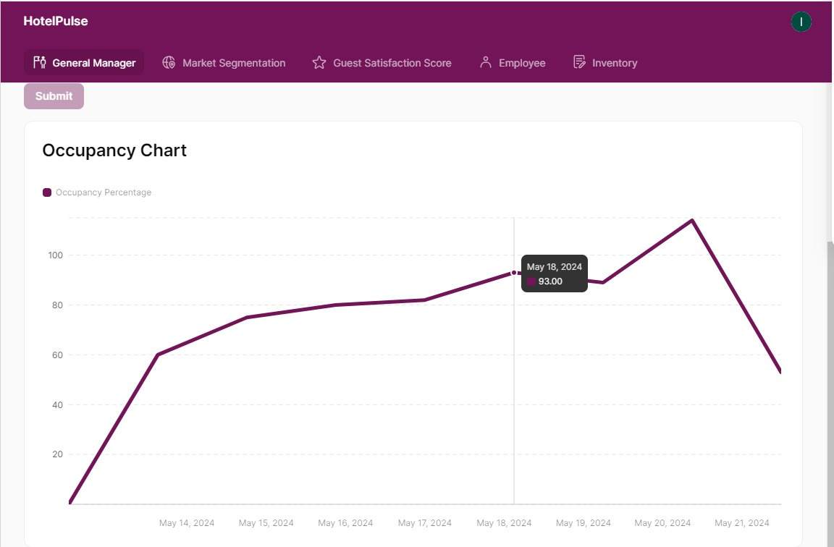
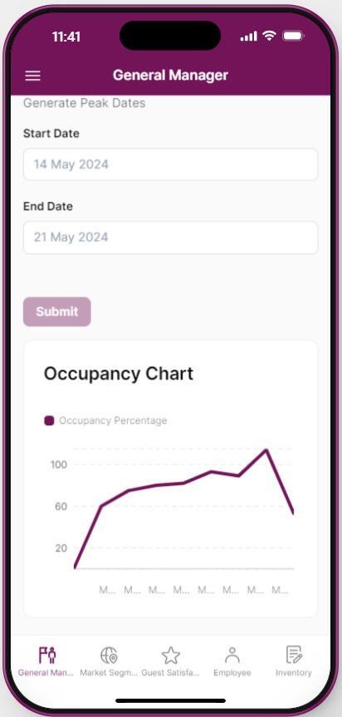
Prototypes
Demand Forecasting

Slide 10
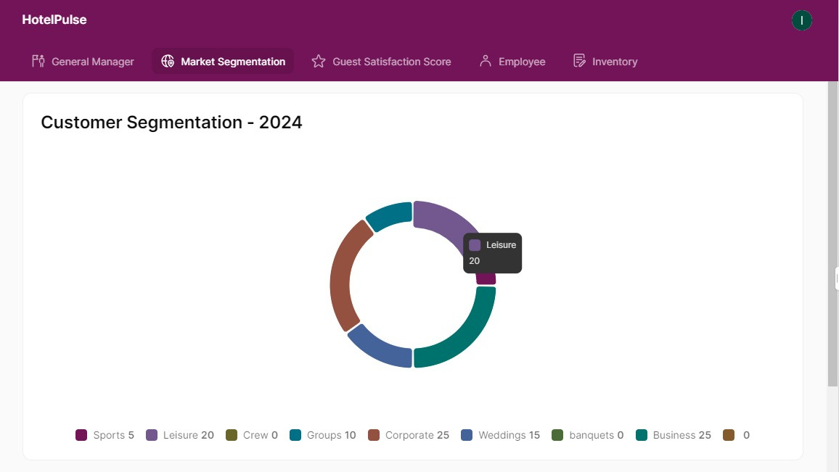
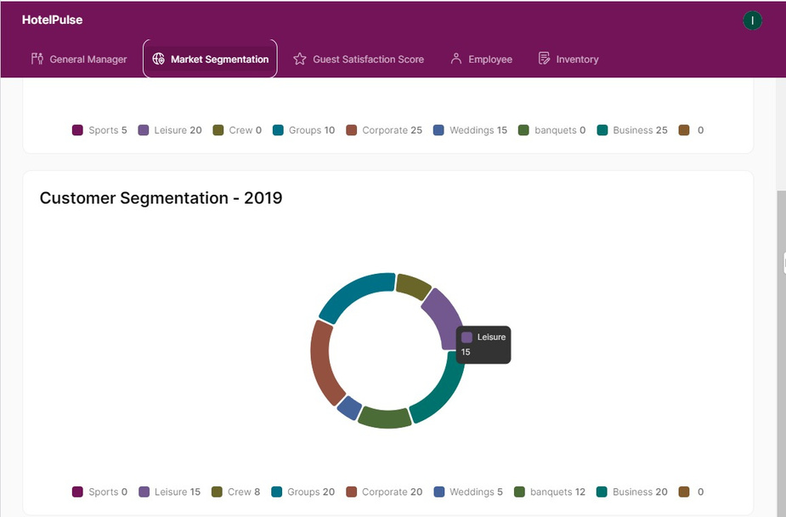
Prototypes
Market Segmentation

Slide 11
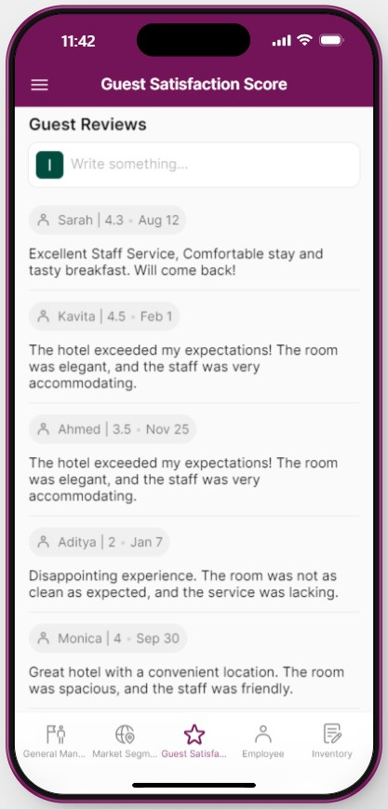
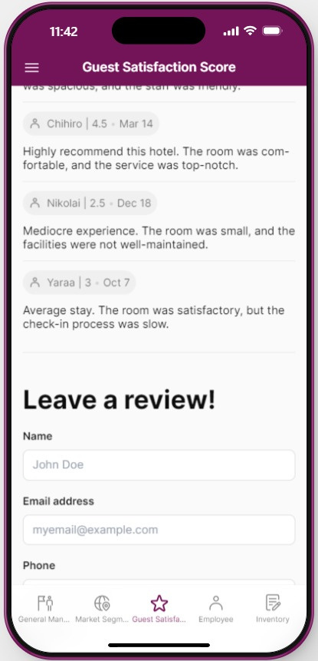
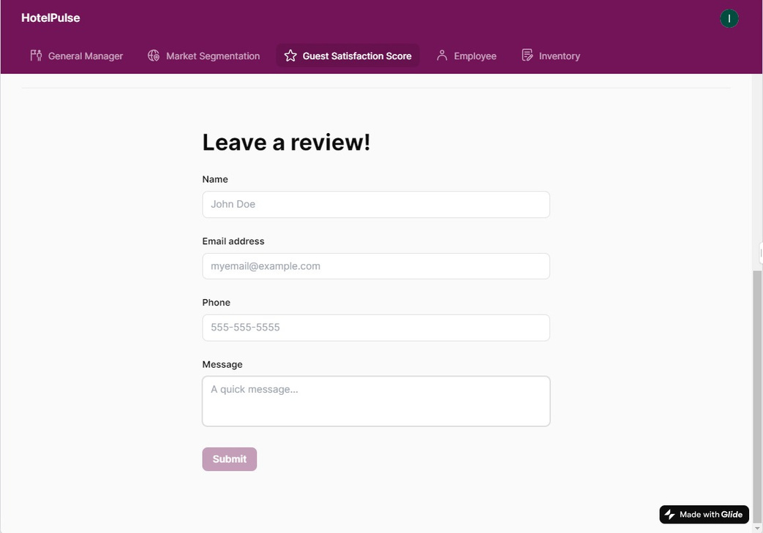
Prototypes
Guest Satisfaction

Slide 12
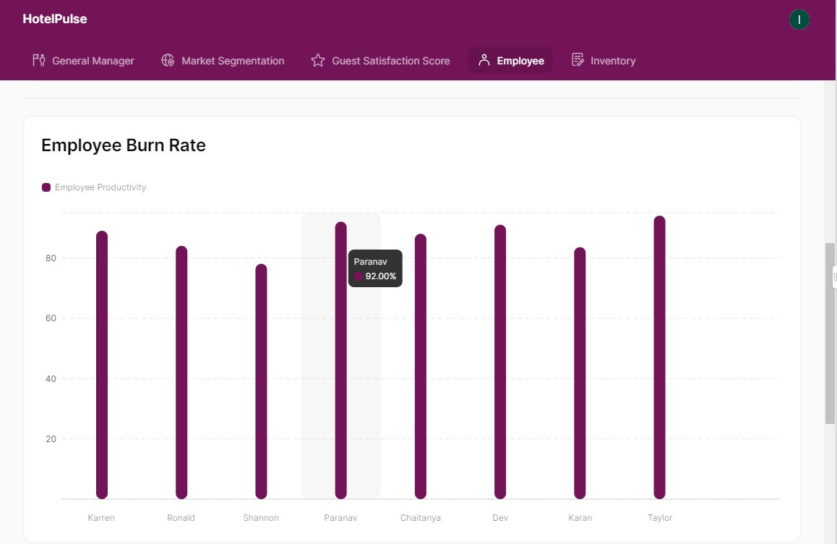
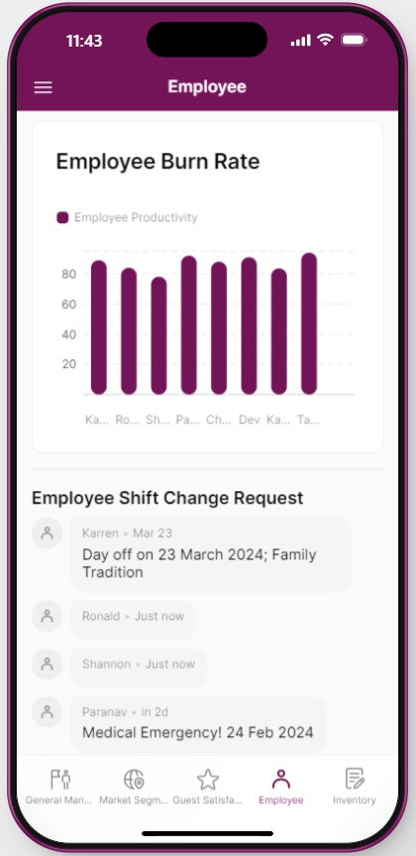
Prototypes
Human Resource Management

Slide 13
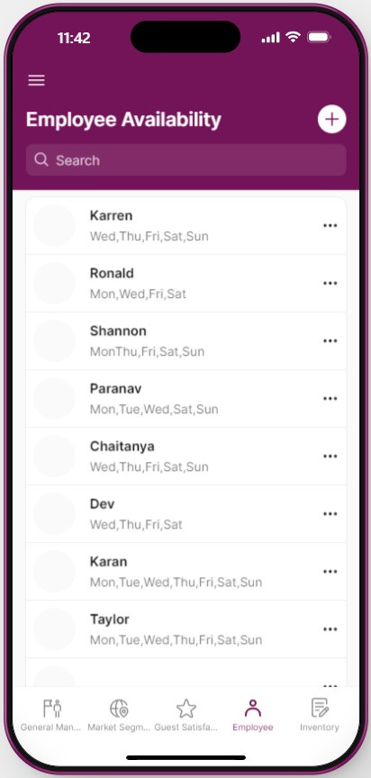
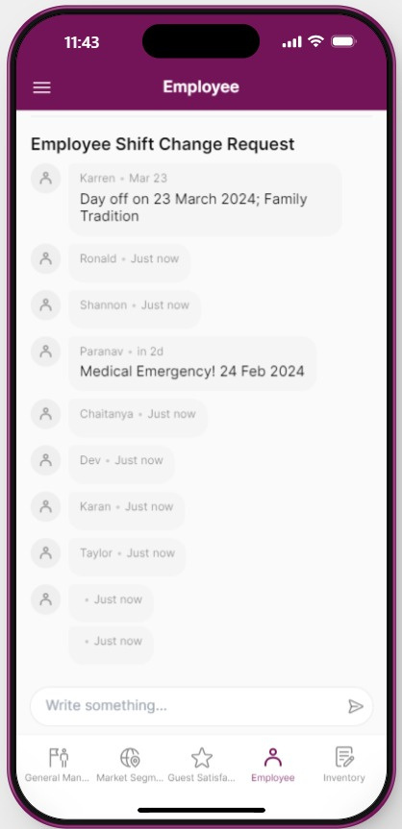
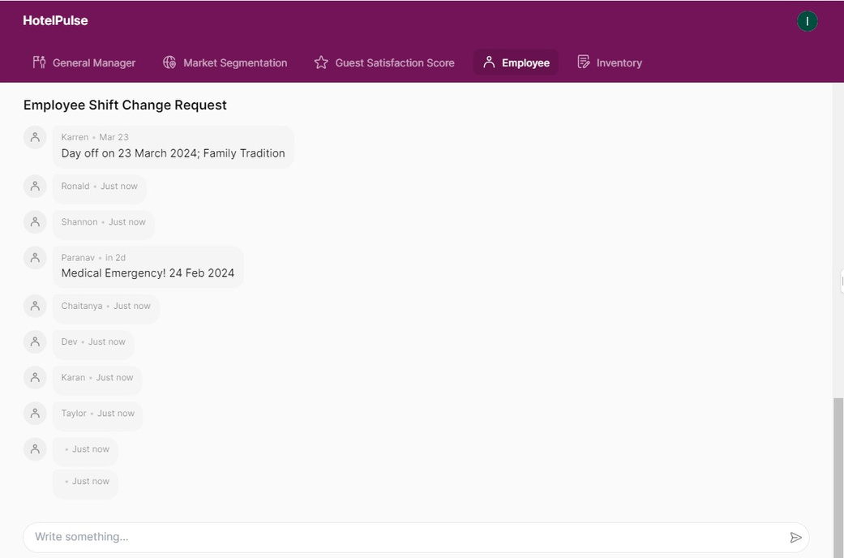
Prototypes
Human Resource Management

Slide 14
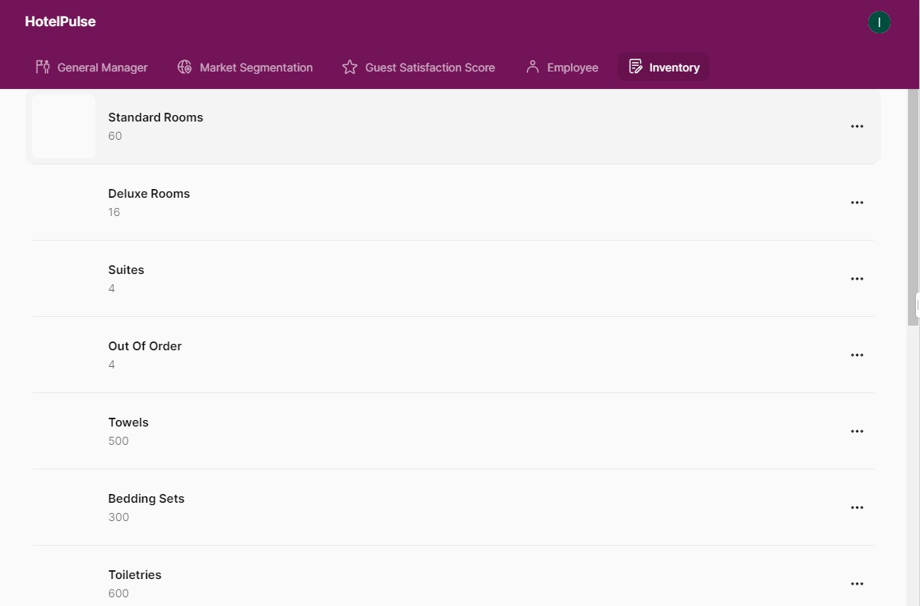
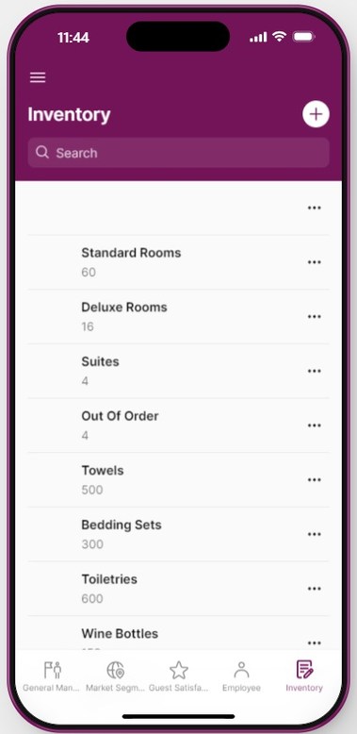
Prototypes
Inventory Management

Slide 15

THANK YOU

